Slide 1
Ray Theory 1. Meridional Rays 2. Skew Rays
EXTC – BE – Optical Communication (ECC703)
Prof. Shyamala Mathi
Assistant Professor
Dept. of Electronics and Telecommunication,
SIES Graduate School of Technology

Slide 2
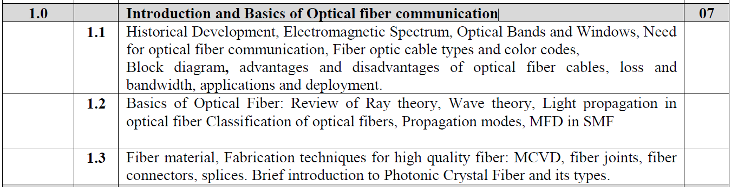

Slide 3

A
A
o
B
B
2γ
C
C
D

Slide 4
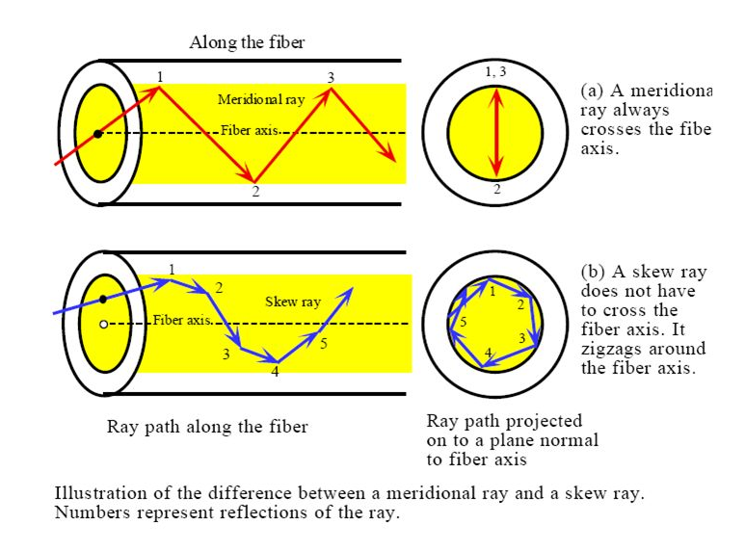
Meridional Rays and Skew Rays:

Slide 5
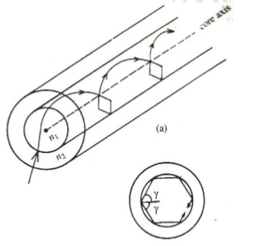
Skew Rays:

Slide 6
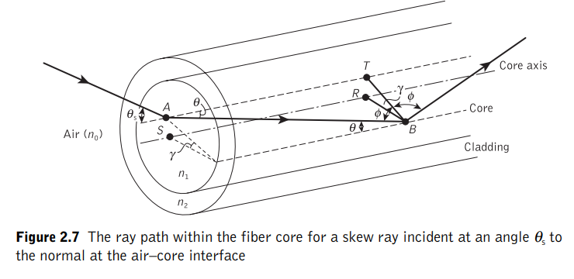
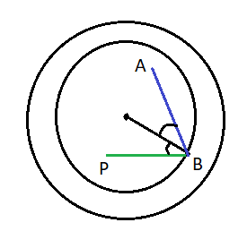
Acceptance Angle for Skew Rays:
P
C

Slide 7
Acceptance Angle for Skew Rays:
P
C

Slide 8
Acceptance Angle for Skew Rays:
P
C
S
C

Slide 9
Acceptance Angle for Skew Rays:
P
C
S
C

Slide 10
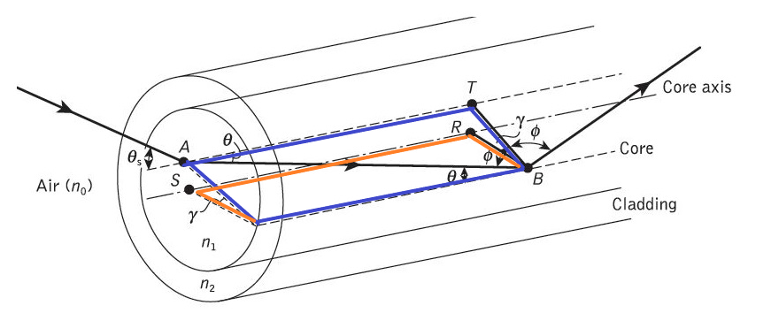
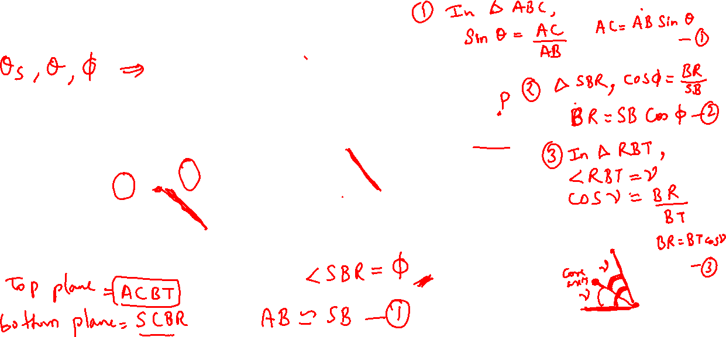


Acceptance Angle for Skew Rays:

Slide 11
Acceptance Angle for Skew Rays:

Slide 12
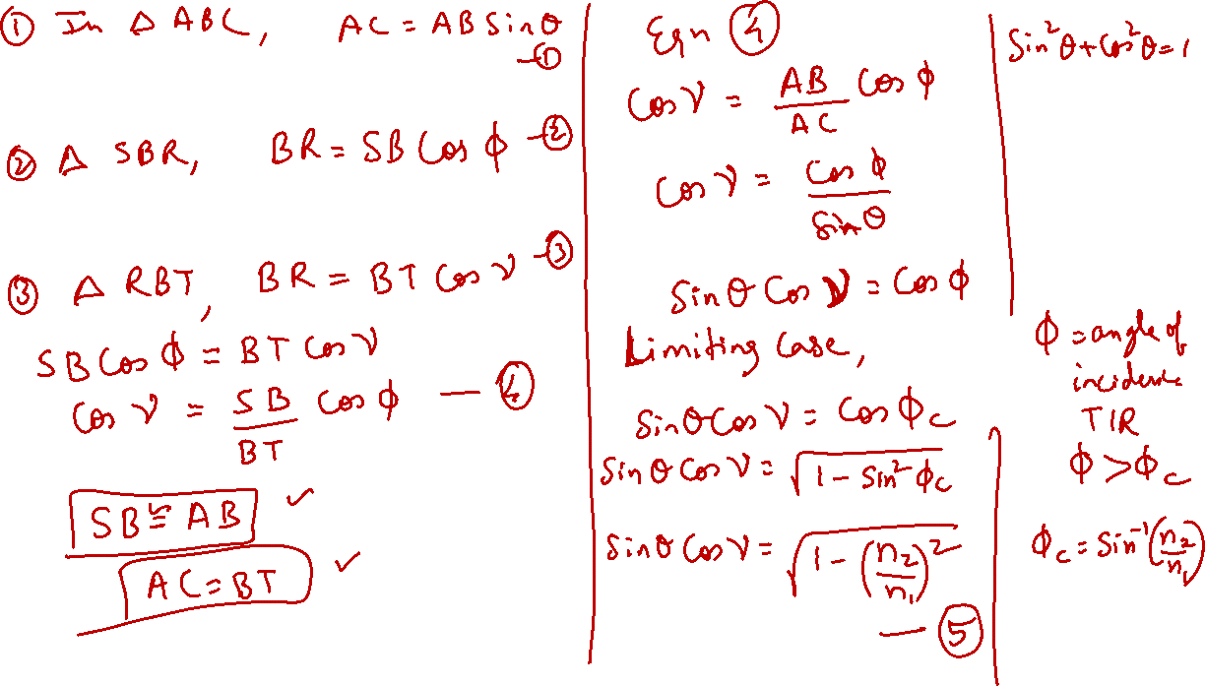

Slide 13
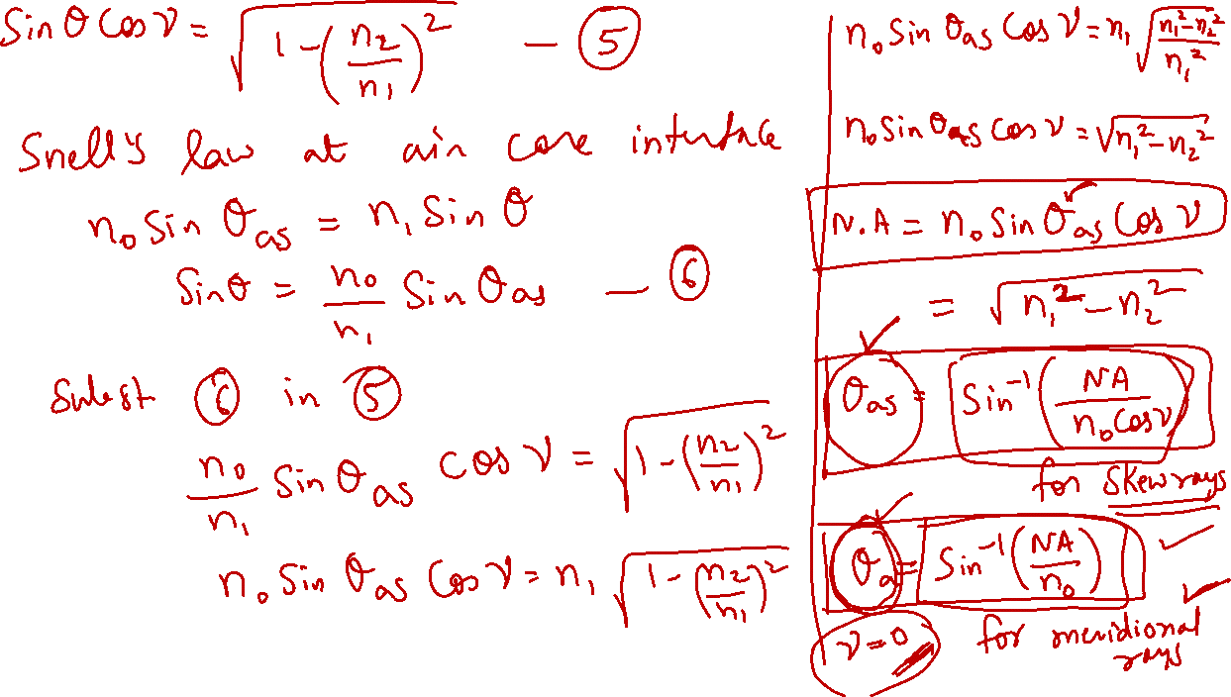

Slide 14
Thank You!
(shyamalae@sies.edu.in)

